Slide 1
PRE-SCREENING SUPPORT
Introduction to
wideraexperts.eu portal

Slide 2
NCP_WIDREA.NET: Transnational Network of National Contact Points (NCPs) for Widening Participation and Strengthening the European Research Area
NCP_WIDERA.NET supports the capacity and effectiveness of the WIDERA National Contact Points in low performing Member States and Associated Countries.
The project aims to support international networking and coordination, and to improve the quality of proposals through better access to services provided by the NCPs during the application process, in particular with regard to Widening Participation and Strengthening the European Research Area, as well as Pillar II actions.
NCP_WIDERA.NET identifies and shares good practices within the NCP community and raises the standard of support provided by NCPs to applicants.

Slide 3
WP8
Advancing Europe Package support
Matchmaking: travel grants for applicants to participate in Pillar II clusters brokerage events, and study visits to advanced partners research institutions
Wideraexperts.eu: portal for NCPs and applicants from Widening countries, where external experts offer professional pre-screening of proposals

Slide 4
For whom?
wideraexperts.eu is a free-of-charge portal that facilitates the matchmaking of experts with applicants from Widening countries preparing proposals within the Widening, ERA, Pillar II clusters, Institutionalised European Partnerships and EIC Pathfinder schemes under the Horizon Europe programme.
Applicant
NCP
Expert
Coordinator or Work Package Leader from a Widening country with an advanced proposal (e.g. including description of work packages, consortium almost formed)
National Contact Points of the following Horizon Europe areas: Widening, ERA, Pillar II clusters and EIC Pathfinder (from a Widening country)
Experienced professionals with a high level of expertise in the field that corresponds to Pillar II, EIC Pathfinder, or Widening participation and strengthening the European Research Area of the Horizon Europe programme
From any country
Excellent command of English

Slide 5
Eligible countries
Project partners
Albania | Greece | Poland
Armenia | Hungary | Portugal
Bulgaria | Latvia | Serbia
Croatia | Lithuania | Slovakia
Cyprus | Macedonia | Slovenia
Czechia | Malta | Spain (OR)
Estonia | Moldova | Tunisia
FST beneficiaries |  | Bosnia & Herzegovina
France OR | Georgia | Kosovo
Montenegro | Morocco | Romania

Slide 6
Why?
The goal is to improve the quality of project proposals, thanks to the feedback applicants receive from the exprts and to increase the participation of Widening Countries in Horizon Europe, thereby raising the level of research and innovation in these countries.
Applicant
NCP
Expert
Free professional pre-screening of the proposal
A tool to match applicants with expert reviewers
External support in the pre-check of proposals to be submitted to HE calls - providing pre-screening service to more applicants
Networking with evaluation experts
Remuneration for the pre-screening service (600 EUR GROSS per proposal)
Experience in the evaluation of project proposals
Networking

Slide 7
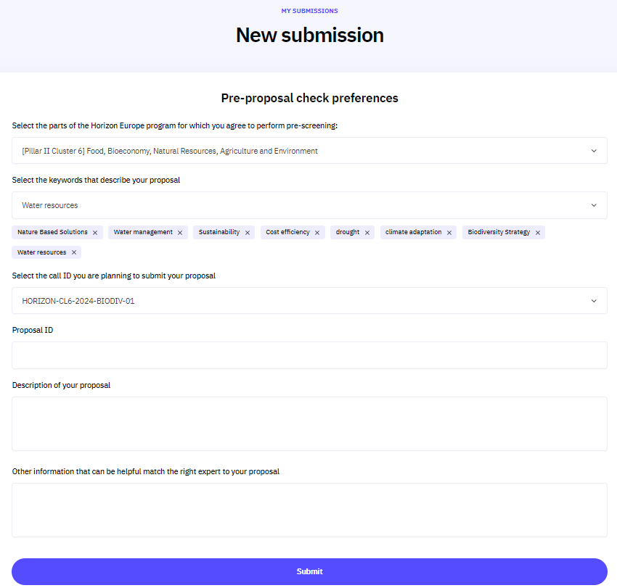
How to register as an Applicant
Register as Applicant and then register your proposal at https://wideraexperts.eu/:
provide email/password
indicate the relevant area of Horizon Europe
select the keywords – as many as you see relevant - matchmaking between the proposal and the expert is done based on the keywords
indicate the call ID and the proposal ID (from F&T)
provide the summary of your proposal and other relevant information
the proposal needs to be as close to a final version as possible. It must be submitted no later than 21 calendar days before the call deadline

Slide 8
How to register as an Expert
Register as Expert at https://wideraexperts.eu/ you need to provide:
Email/password
Personal details/Contact details
Preferences: select the keywords – as many as you see relevant - matchmaking between the proposal and the expert is done based on the keywords
Upload your CV
Provide additional information regarding your skills

Slide 9
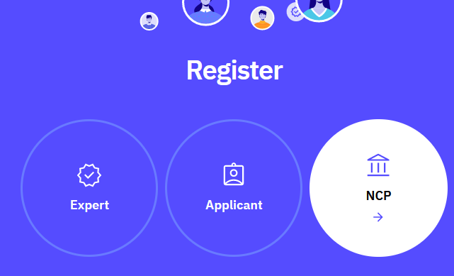
How to register as NCP?
To register as NCP in the wideraexperts.eu portal please provide:
Personal data
Contact data
Thematic area
Please pay attention when indicating your thematic area(s), as this will allow you to see the applications submitted for pre-screening from your country: NCPs from a given thematic area and country see the applications only from the country they represent and the thematic area they have provided in the registration form. Only these applications can be assigned to an expert for pre-check.
Your NCP account must be approved by the administrator before you can log in.

Slide 10
NCPs matches proposal to expert
In the APPLICATIONS tab NCP sees the list of applications. By clicking on the GROUP icon on the right-hand side, NCP can see which experts can be selected to pre-check the application.
NCP can check the details of the expert profile.

Slide 11
NCPs found the expert: what’s next?
Based on the expert's profile and, if applicable, rating of the level of service provided, the NCP selects from the list of available experts the most suitable one to pre-check the proposal
The NCP contacts the selected expert, presents the conditions of the pre-screening process and basic information about the proposal.
NCP signs a contract with an expert who has agreed to perform the pre-screening. The contract includes, inter alia, confidentiality clauses and an evaluation form.

Slide 12
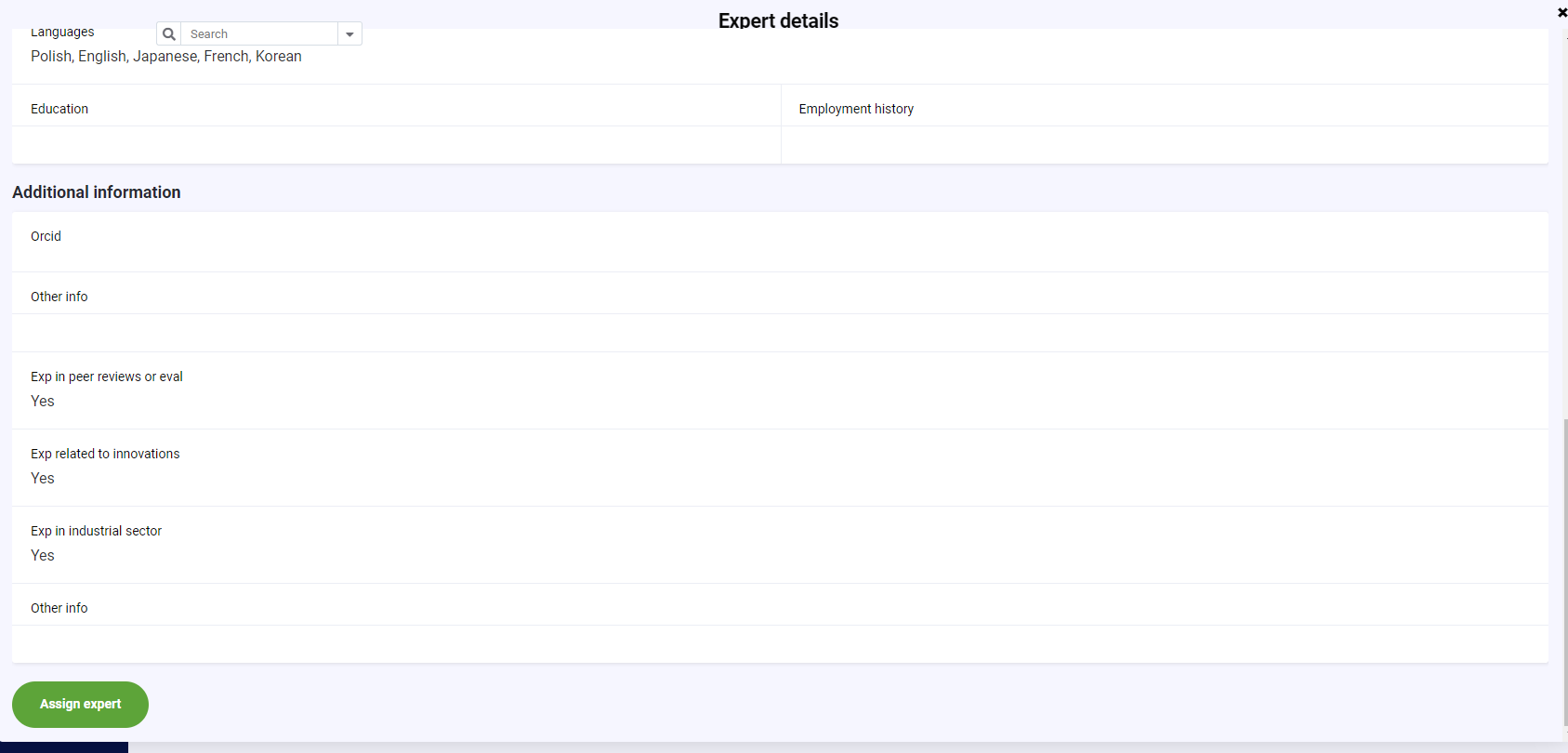
Assignment of the expert to the proposal
Once the contract has been signed, the NCP can assign an expert to the application via the ASSIGN EXPERT button in the EXPERT DETAILS tab. Only now does the expert receive detailed information about the proposal.

Slide 13
The Expert receives the proposal and agrees with the Applicant on how to proceed
The Applicant sends advanced parts of the proposal (Part B) to the expert.
Consultations, discussions, an online meeting etc.
The Expert prepares written recommendations for the Applicant according to the template from the contract and sends it to the NCP for approval
After delivery the expert must complete the details (report) of the pre-check provided (including dates, meeting with applicant/hours devoted and remarks)
The expert also uploads the recommendations (form agreed with applicant)

Slide 14
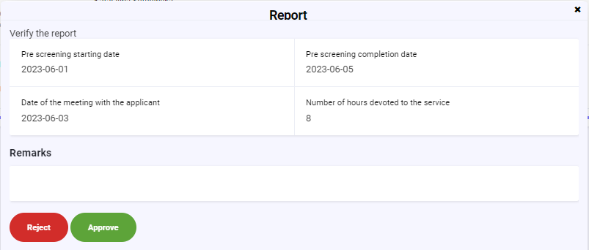
NCP: review of the expert's report and recommendations
The Expert sends the recommendations to the proposal and a report on the pre-screening process via the portal
The process status in the portal changes to Verification needed
NCP can download the recommendations and assesses the conformity of the service with the contract. In the event of non-compliance, NCP contacts the Expert.
NCP forwards the accepted documents to the Applicant via the portal.

Slide 15
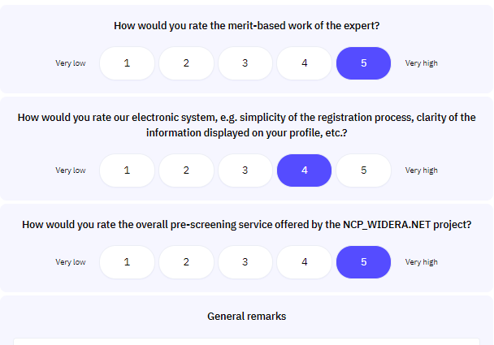
The Applicant receives recommendations and rates the Expert
Upon receipt of the recommendations and the pre-screening process report, the Applicant completes the evaluation questionnaire to rate the Expert and the service.
If the Applicant has no objections to the pre-screening process report and the recommendations, the NCP informs the Expert that the service has been successfully completed, which is the basis for the remuneration.
The information about Expert's rating in his/her profile helps to improve the selection of experts in the subsequent pre-screening process.

Slide 16
The pre-screening process
NCP: presents the contract (including the confidentiality agreement) to the expert for signature
Registered NCP is notified that a proposal from its thematic area has been submitted for pre-check
NCP: analyses the form and searches for an expert matching the topic of the proposal
NCP: selects an expert on the basis of his/her profile, contacts the expert, proposes the service, presents the conditions
The Applicant registers in the portal and fills in the information form
Expert: accepts the conditions
Expert prepares the evaluation report: 1) recommendations (according to the template included in the contract) and a report from the service (questionnaire in the portal)
NCP: NO -> sends back the reports to the expert and discusses how to correct or complete the documents
Expert + Applicant contact each other, establish technical rules
on how pre-screening will be done, discuss the process and method of communication
NCP: once the contract has been signed, NCP can assign the application to an expert in the portal
NCP: is notified that the reports have been submitted
NCP: analyses the reports and accepts them or not
NCP: YES -> sends the report and recommendations to the Applicant
NCP: is notified that the Applicant has rated the expert and the service
-> informs the expert that the service has been accepted
The Applicant receives feedback and recommendations, the NCP has supported the improvement of the proposal and established contacts, the Expert has gained additional experience and has been remunerated
Applicant:
takes note of the expert's recommendations
Applicant: takes them into account as he/she sees fit
Applicant: rates the Expert in the portal
Expert: sends a request for payment (template in the contract)
NCP: sends the request for payment to be processed in the organization

Slide 17
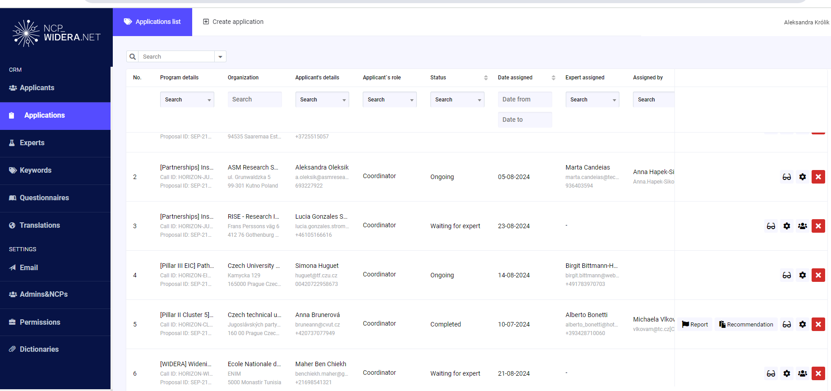
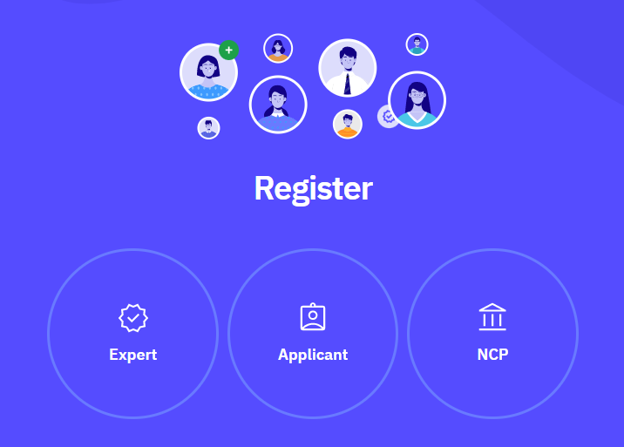
STATISTICS: Pre-screening of proposals
Users:
900 Experts
137 NCPs
80 pre-screenings via the portal

Slide 18
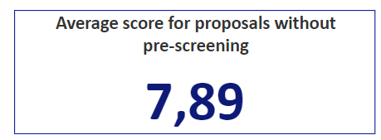
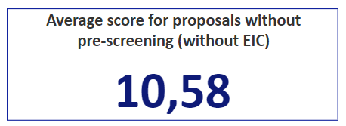
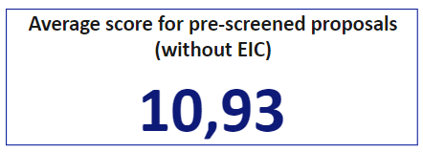
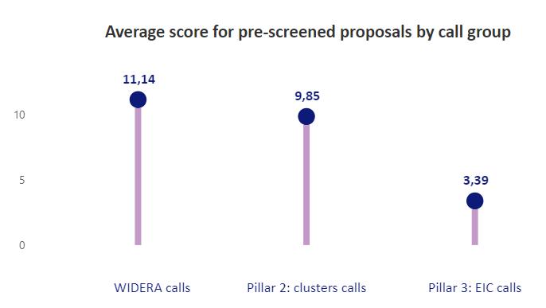
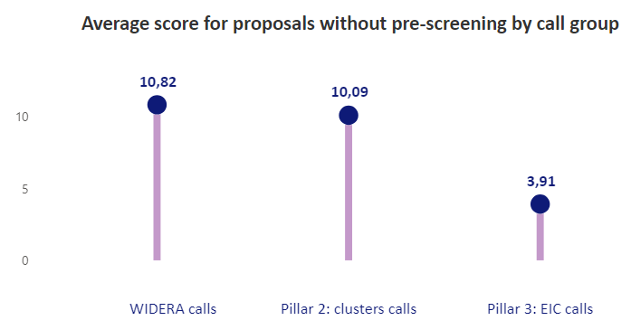
STATISTICS: Pre-screening of proposals
Scores for pre-screened vs not pre-screened proposals (mixed mode)
Not pre-screened
Pre-screened

Slide 19
Feedback from the applicants
(…) We got very helpful recommendations regards both the research part and both the impact and other parts of the proposal. In our case we had a meeting with our NCPs as well and it was definitely worth to have more people involved.
The service helped enormously the team preparing the Twinning proposal. Since the team had no experience with preparation of a proposal in Horizon Europe, the evaluator´s comments helped a lot to understand the requirements of the call, the sense of the information to be provided in each section of the proposal and the role of the evaluator.
The service significantly contributes to the quality of the proposal. It is, in my view, one of the most effective ways how to help coordinators from Widening countries to close the gap with regard to their experienced counterparts.
Very useful service, especially for those with low experience in handling EU projects.
The reviewer provided comprehensive feedback on the Excellence and Impact Sections, covering not only technical aspects but also market perspectives. Our interaction lasted over 4 hours and greatly enhanced our proposal across all areas.
Extremely good. Despite the short deadline, the expert was very efficient in providing me with the relevant feedback. (…) Very good initiative, it should be made permanent service.
The expert assigned was very qualified, gave very interesting remarks and feedback. (…)The expert has the arts & crafts & history & culture background, very high level of knowledge.
The interface is client oriented, very clear and simple. The work of the expert was very professional and well structured. The communication of the recommendations was also very clear, no ambiguities.

Slide 20
Feedback from NCPs
(…) Thanks to the prescreening database, we got our Teaming-2 proposals invited to Grant Agreeement
Polish NCP
(…) Two proposals pre-screened by experts from NCP_WIDERA.NET. received each a score of 15.
Romanian NCP

Slide 21
Important Information
Internal process

Slide 22
Important information for applicants
Submit your proposal
4 weeks before the call deadline
The proposal
advanced grants are needed
Contact your NCP
at all times, especially in case of issues

Slide 23
Information for experts
Experts sign a Model Contract developed by the NCP_WIDERA.NET and used by the project partners
Expert fees: 600 gross
Subject to VAT (24%) and applicable taxes
We need an invoice
Expert service of up to 20 hours

Slide 24
Information for experts
1. NCP matches the expert – proposal
2. NCP communicates with the expert
3. NCP sends the model contract to expert
4. NCP sends the model contract countersinged by FORTH
5. The service begins

Slide 25
Go to wideraexperts.eu and register today! Feel free to contact us!
mikroni@praxinetwork.gr
vkalodimou@praxinetwork.gr
widera@ncbr.gov.pl

